Slide 1
Analysis of Sports Injury
AI project

Slide 2
Our Project
Our project predicts the injuries based on the given data and identify the features most contributing to the injuries
We have used "Pandas", "Matplotlib" and "Numpy". Also we have used "pylab" which is a convinence module of Matplotlib and Numpy.
It takes data of 30 real players from 2016 to 2018 recorded daily.
As a result it provides multiple graphs explaining the causes and probability of injuries in different sports.

Slide 3
Datasets Used
The dataset contains 3 files with information about the players metrics, game workload and injuries with attributes like athlete ids, date, workload, metric (hip mobility, groin squeeze).
Dataset description
Metrics dataset: provides data of hip mobility and groin squeeze of 30 athletes recorded every day from 01/05/2016 to 30/04/2018.
Workload dataset: provides workload taken by each athlete on a game day.
Injuries dataset: provides the dates on which the athletes were injured during a game.

Slide 4
Technologies used
It is completely made on Python.
We have used jupyter notebook as our coding IDE.
For storing the datasets "Pandas" library has been used.
For calculation of complex mathematical problems and operations "Numpy" library has been used.
For the plotting of graphs and visual representation of the resulting data we have used "Matplotlib".

Slide 5
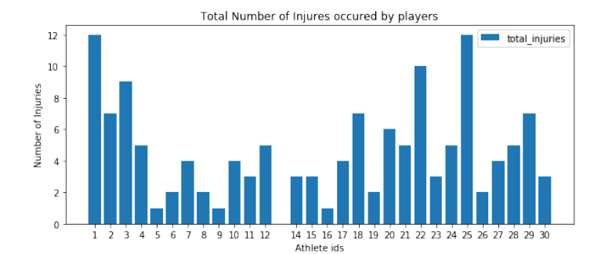
Exploratory Data Analysis
By performing basic statistical operations we obtained a few of the following snapshots:

Slide 6
Analysis Explanation
Most number of injuries were occurred to athlete with id 12. Athlete with id 13 has not been injured at all.
Below is the graph with number of injuries per athlete
Maximum and minimum workloads taken by an athlete in a game are 534 (by athlete id: 10) and 225 (by athlete id: 13) respectively.
Maximum and minimum number of games played are 101 (by athlete id: 3) and 65 (by athlete id: 5) respectively.
Calculated Fitness ratio for each player, from the total number of games played and the number of injuries sustained in those games using the formula:
fitness_ratio = (1- (num_of_injuries / total_num_of_games))*100
From the above formula, it was observed that athlete 13 had the best (100 fitness ratio, since he does not have any injuries) and athlete 1 had the least fitness ratio

Slide 7
Visual Representations

Slide 8
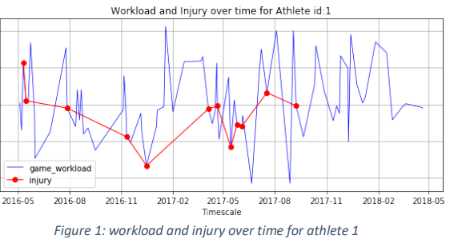

Slide 9
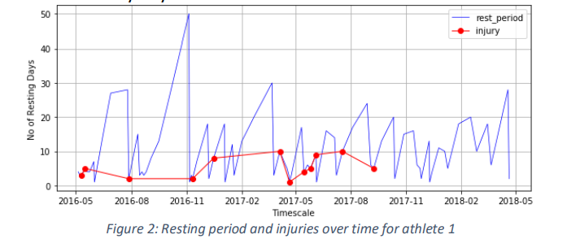

Slide 10
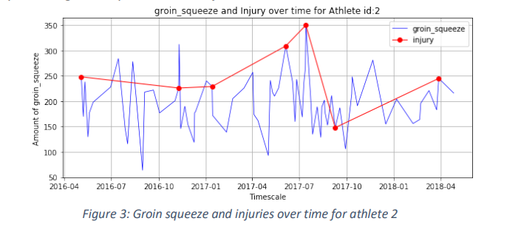

Slide 11
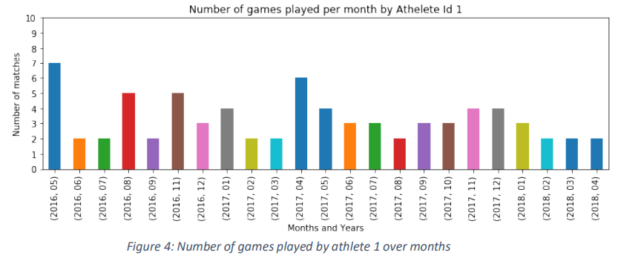
Number of games played by each player is plotted as below to see the distribution

Slide 12
Conclusion
The major task in this analysis was to identify the reasons behind athlete being injured based on the provided data. As per my analysis, it is observed that Groin squeeze and resting days (gap between two consecutive games) are the two driving factors that impact the occurrence of injury to an athlete. With high metric value of groin squeeze and less number of resting days, athletes are more likely to be injured in a game.

Slide 13
Github Project link:
https://github.com/PrimisOnStage/Sports-Injury-Analysis/tree/main

